Slide 1
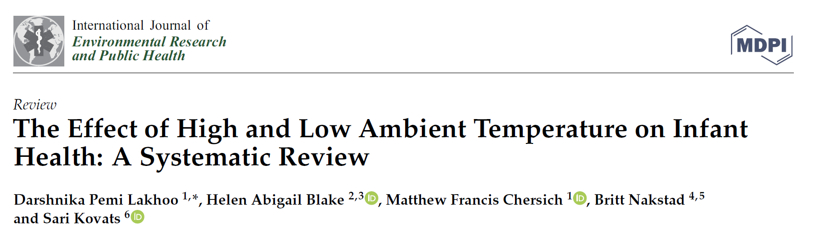
The Effect of High and Low Ambient Temperature on Infant Health: A Systematic Review
Darshnika Pemi Lakhoo, Helen Abigail Blake, Matthew Francis Chersich, Britt Nakstad and Sari Kovats
Dr Darshnika Pemi Lakhoo (MBChB (UCT), MSc Public Health (LSHTM)
21.09.2022
ISEE Conference, Athens

Slide 2
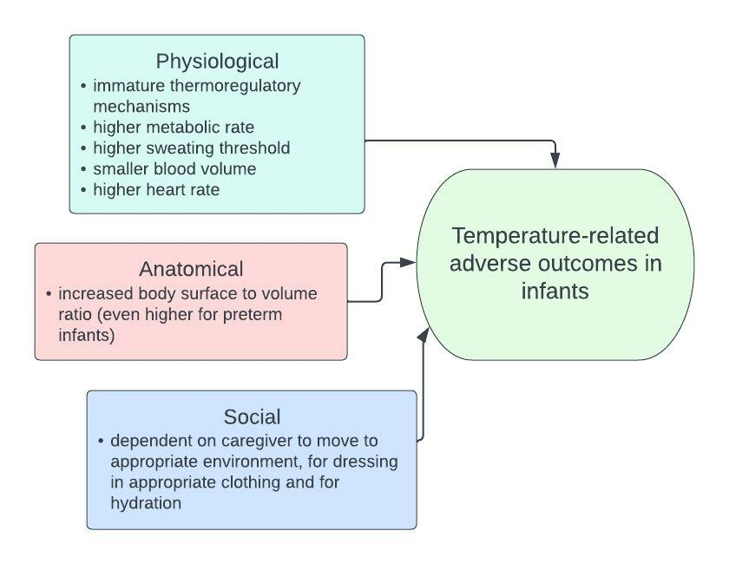
Temperature and infant health
Notes:
Perhaps boxes can be aligned better? As MF always says reduce the white space

Slide 3
Aims and study population
To explore the association between acute adverse infant outcomes and exposure to high and low ambient temperatures
PECOS Framework
People: Infants 0-1 years old
Exposure: Short term weather related ambient temperature exposure after birth
Outcomes: Any adverse health outcomes excluding birth outcomes (stillbirth preterm etc.)
Setting: Any country/region

Slide 4


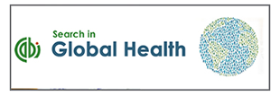


Methods
Methods
Inclusion and exclusion criteria
Epidemiological studies from 2000 onwards published in English
Modified OHAT Risk of Bias

Slide 5
Results
Records identified through database searching (n = 2724)
Additional records identified through reference list searches (n = 15)
Identification
Records excluded based on title and abstract (n = 2332)
Screening
Records after duplicates removed (n = 2396)
Full-text articles excluded, with reasons (n = 35)
no specific analysis for age group 0-1 year (n = 15)
monthly temperature or seasonality as exposure (n = 13)
diurnal temperature as exposure (n = 2)
unable to access full text (n=3)
letter to editor (n=1)
conference abstract (n=1)
Eligibility
Full-text articles assessed for eligibility (n = 64)
Studies included in synthesis (n = 26)
Included
Notes:
Wits RHI log is being overlapped. Perhaps you can remove it?

Slide 6
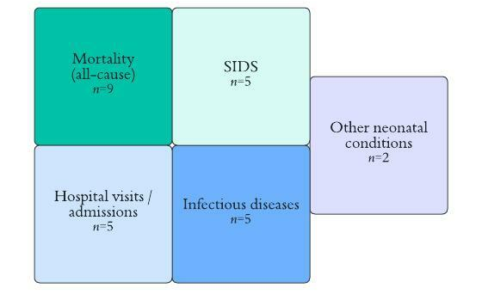
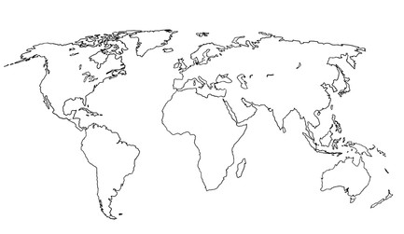
Results
n=7
n=7
n=9
n=3
Notes:
It seems essential to make the point that there are no African studies.

Slide 7
Results

Slide 8
Key findings
Infant mortality
Higher mortality with higher and lower temperatures
SIDS
Inconclusive evidence: heterogenous study design, detection bias, small sample sizes, incomplete evidence
Hospital visits/admissions
Increase all-cause admissions with higher temperatures
Infectious diseases
Increase HFMD with higher temperatures Increased bronchiolitis with lower temperatures
Other
Higher INR and neonatal jaundice with higher temperatures

Slide 9
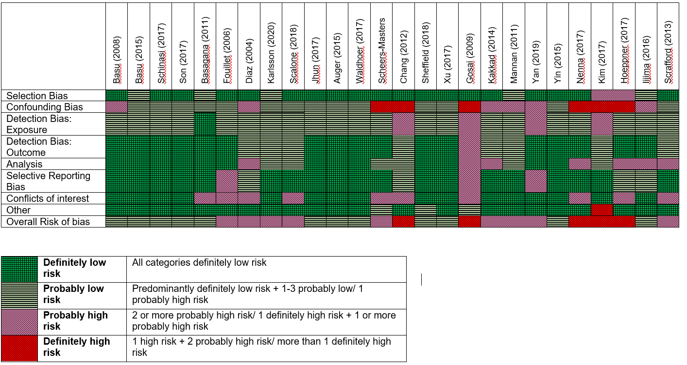
Risk of bias

Slide 10
Knowledge gaps
Future research
Wider, representative distribution
Infectious diseases
Improved quality and consistent measures
Vulnerable subpopulations

Slide 11
Summary

Slide 12


Thank you
Acknowledgements: Study authors and supervisors: Helen Abigail Blake, Matthew Francis Chersich, Britt Nakstad and Sari Kovats, Wits RHI Climate and Health Directorate , CHAMNHA, HEAT Center
Contact: dlakhoo@wrhi.ac.za

